Slide 1


THREATIFY- Threat Detection using CCTV
Mid Evaluation
Group Members: Muhammad Abdullah i170038 Haasha Bin Atif i170183 Muhammad Ahmed i170184
Supervisor: Dr. Omer Ishaq

Slide 2
Content
Poster
Progress
Use Case Diagram
Data Collection and Cleaning
Threat Identification
Implementation Detail
Results
Q&A

Slide 3
Poster

Slide 4
Progress
Website Development
Testing & Optimization
Data Collection & Cleaning
Threat Identification
Threat Classification Iter#1
Model Deployment
Threat Classification Iter#2
4

Slide 5
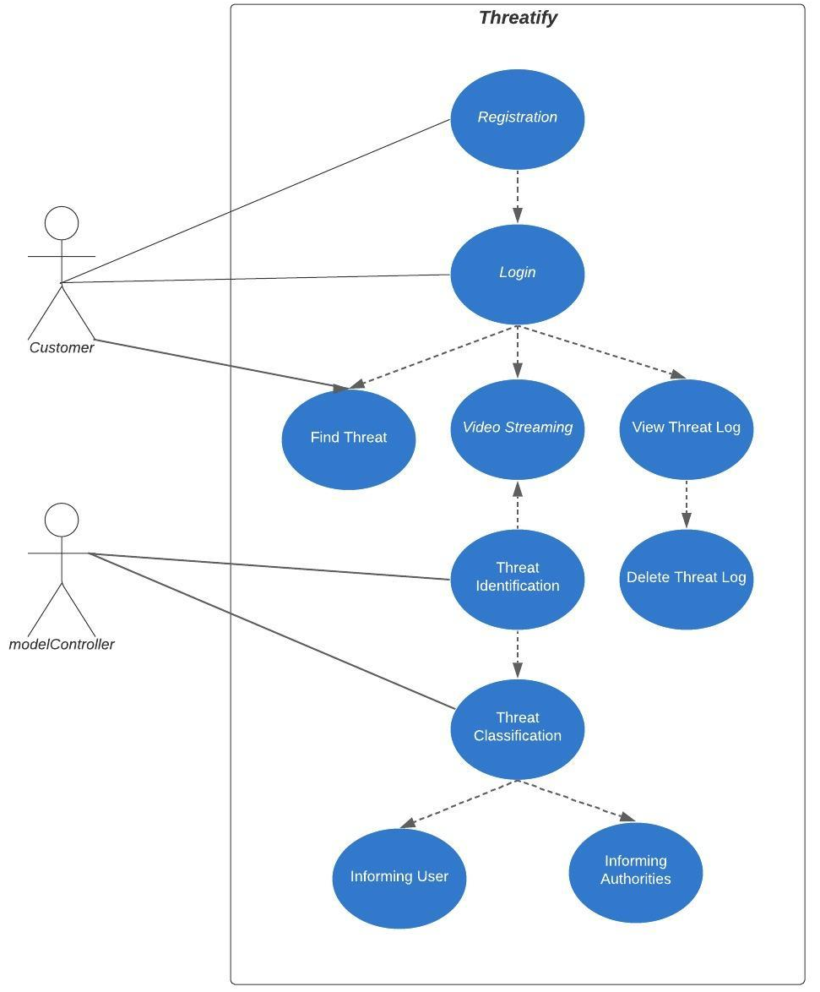
Use Case Diagram
5

Slide 6
Data Collection & Cleaning
Datasets:
UCF-Crime Dataset
RWF
Data Refining(elimination of very long and useless videos)
Annotation of Normal Videos

Slide 7
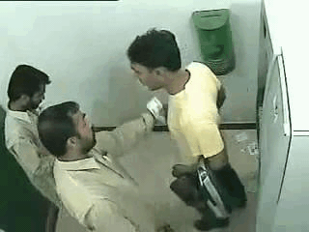
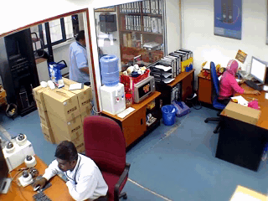
Threat Identification
Binary Classification
Threat Non-Threat

Slide 8
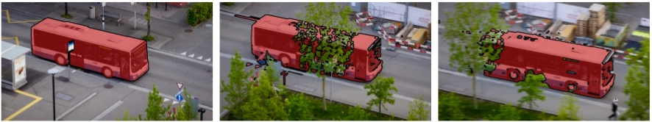
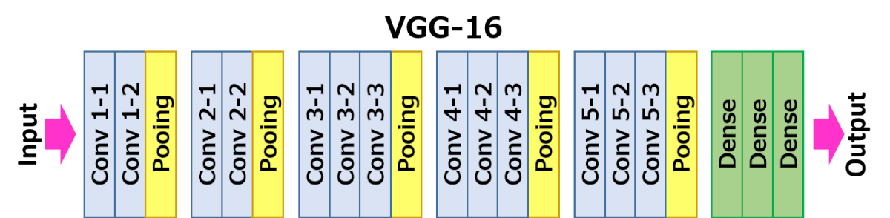
Implementation Details
Video Segmentation
Model Architecture
LSTM
LSTM
LSTM
VGG-16

Slide 9
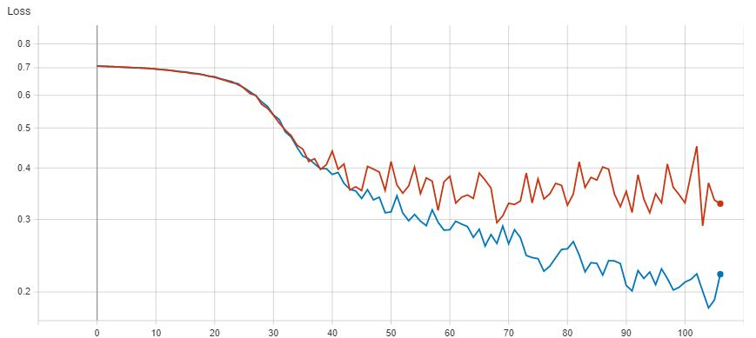
Results-Loss
Train
Test
Train
Test
Loss
Epochs

Slide 10
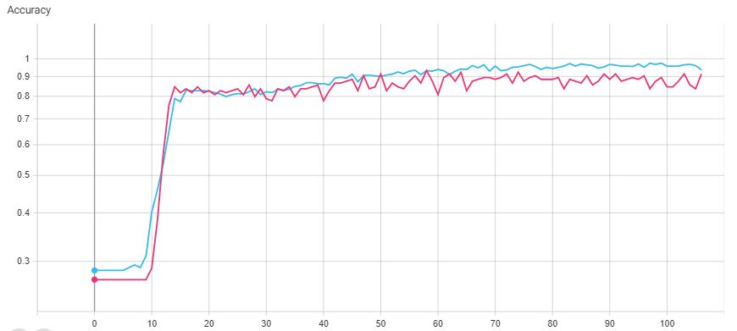
Results-Accuracy
Train
Test
Accuracy
Epochs

Slide 11
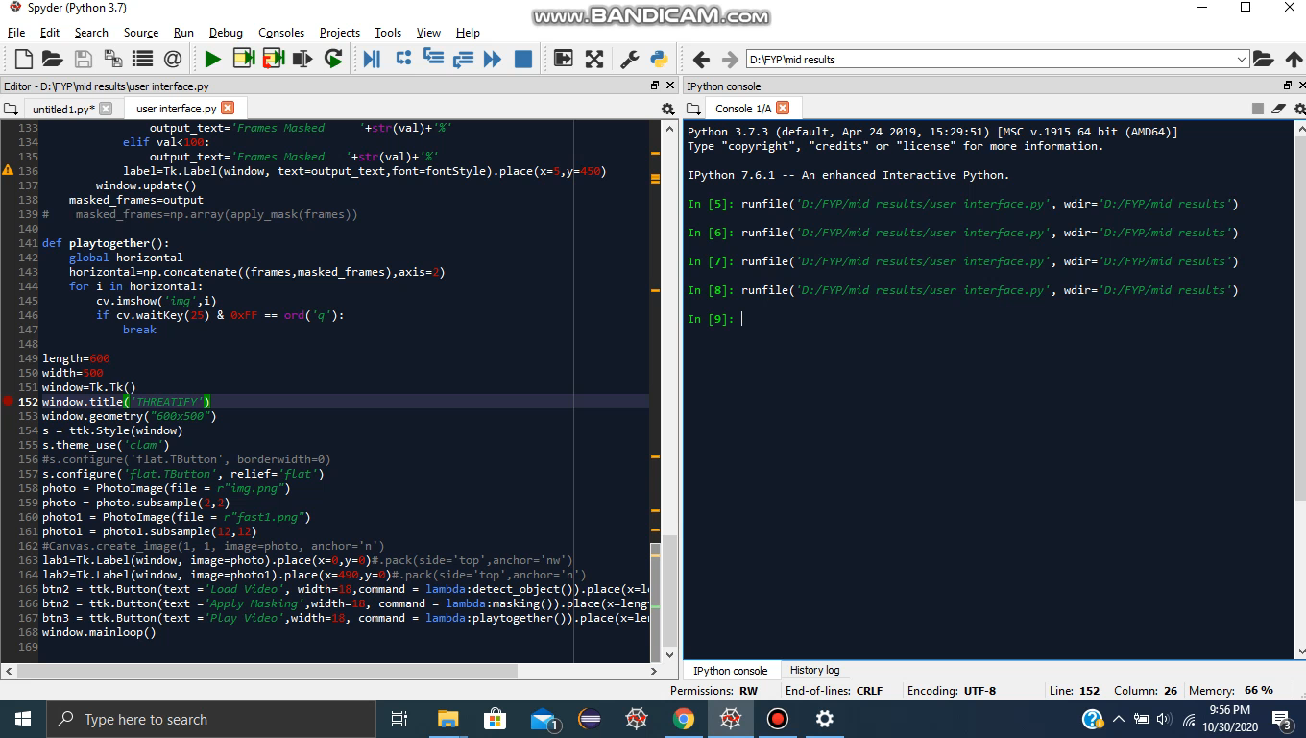
Results-Masking

Slide 12
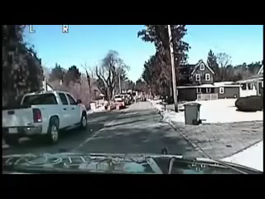
Results- Threat I

Slide 13
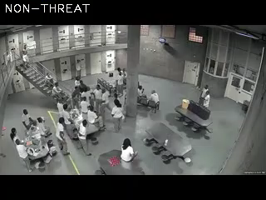
Results- Threat II

Slide 14
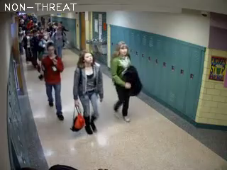
Results-Non Threat

Slide 15

Thanks!
Any Questions?

